Slide 1
Moneyball: What Are You Paying For?
Team London
Alan Bunbury Gizelle Lao
Laura Camacho Maryna Khatnyuk
Muhammad Ali Mirza
Notes:
Quick:

Slide 2
Introduction
Billy Beane and his advisors at Oaklands A’s had differences of opinion while assessing players for making a replacement.
Approach Towards Player Assessment
Advisors/Market
Conventional.
Subjective observation (e.g. strong appearance).
Traditionally valued evaluation metrics (e.g. number of home runs hit).
Billy Beane
Unconventional.
Objective analysis based on data.
Evaluation metrics correlated with winning (e.g. on-base percentage).
Notes:
Before we get into the analysis , we give you the introduction

Slide 3
Billy Beane’s Strategy
Use data analysis to identify key abilities: significant correlation with winning.
Identify undervalued players: high on key abilities, low on salaries.
Effective and efficient: a team with statistically proven winning abilities at a lower cost.
Not sustainable if the market adopts data-driven approaches.
Source Of Competitive Advantage
Advisors/Market
Team’s wealth/resources: Invest in premium players.
Inefficient resource allocation and less consistent results.
Billy Beane
Data-driven analyses: Find and invest in undervalued players.
Efficient resource allocation and more consistent results.
Notes:
It is not sustainable but it is a source of competitive advantage. Overtime , it is not sustainable because every other team can apply this practice.

Slide 4
Qualitative Impacts On Team Performance
Health
Good fitness: Able to fully utilize capabilities, leading to better performance.
Sickness/Injuries: Limited abilities compromise performance.
Team dynamic
Team-focused: Prioritizes team goals and makes sacrifices to achieve them.
Self-focused: Prefers to pursue individual goals, which may not be aligned with team goals.
Attitude and Emotional Wellbeing
Positive: Brings good vibes that boost team spirit and performance.
Negative: Creates negative feelings, such as resentment or disappointment, which lower team morale and performance.
Notes:
There are qualities that influence the success but it is hard to measure to plug to the statistical model.

Slide 5
Qualitative Impacts On Team Performance
Commitment
Full: Persistence boosts performance and may also inspire the team, leading to a snowball effect.
Partial: Lack of motivation leads to poor performance.
Confidence
Strong: Helps deliver best performance and allows domination.
Poor: Showing weakness may give the upper hand to the other side.
Evaluation of a salesperson solely on their financial performance:
They bring value to their company in other qualitative way as well
Emotional connection
Being resilient

Slide 6
Project Requirements
Goal
Build a team of 15 players while maximizing WAR.
Constraints
$190M salary cap
At least 3 of the top 10 HR hitters
At least one of shortstop, second base, third base, and first base
At least three middle infielders
At least three corner infielders
At least four outfielders
At least two catchers
Notes:
Highlight Question 3A)
Avoid too technical terms, but still provide it?
i.e. slack – “we have extra moonies”
Wins Upon Replacement

Slide 7
Method
Using solver on the data, the solving method was changed to Simplex LP, which uses a linear model to come up with a solution.
A linear model was chosen because it produces the absolute optimal solution ¹, which will not change on multiple runs. Non-linear models may output different solutions when running the model multiple times. The solution provided by a non-linear model may not be the most optimal one.
Solver automatically selected team members for the roster, based on the provided constraints.
¹ https://support.microsoft.com/en-us/office/using-solver-to-determine-the-optimal-product-mix-c057e214-962f-4339-8207-e593e340491f
Notes:
Highlight Question 3A)
Avoid too technical terms, but still provide it?
i.e. slack – “we have extra moonies”

Slide 8
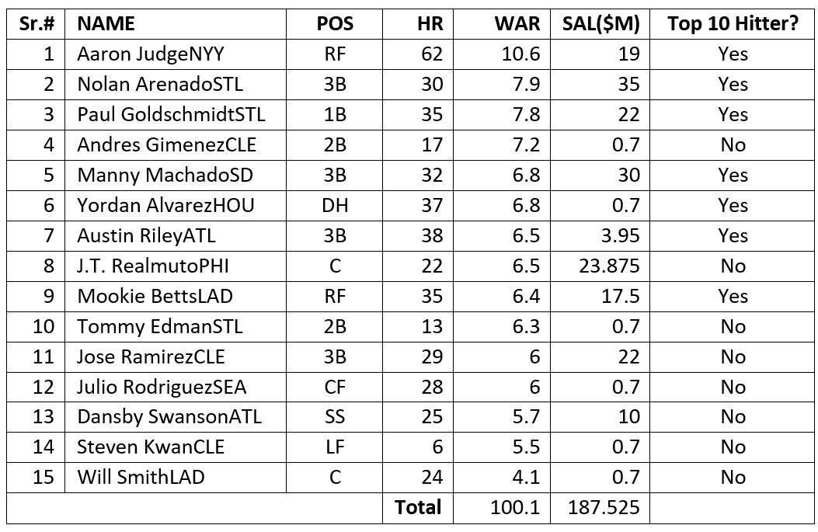
Results - Team London
Notes:
ased on our Solver’s results, this is our best possible team of 15 players. We have a WAR score of 100.1 and a total team salary $187.525MB

Slide 9
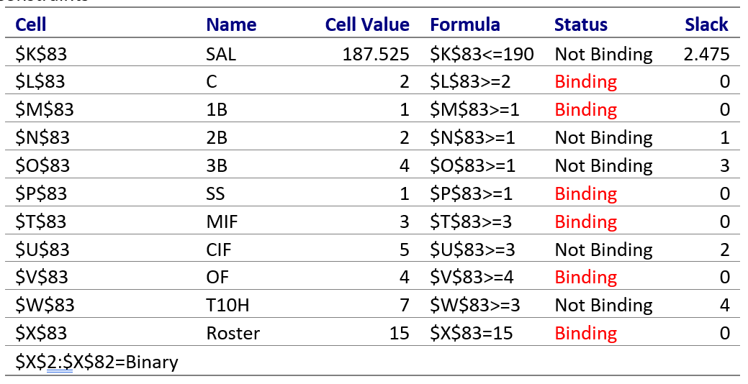
Binding And Non-Binding Constraints
Notes:
Binding constraints are the ones that the optimal solution depends on. There’s no slack or buffer available for those variables. Non-binding constraints are not critical to the optimal solution.

Slide 10
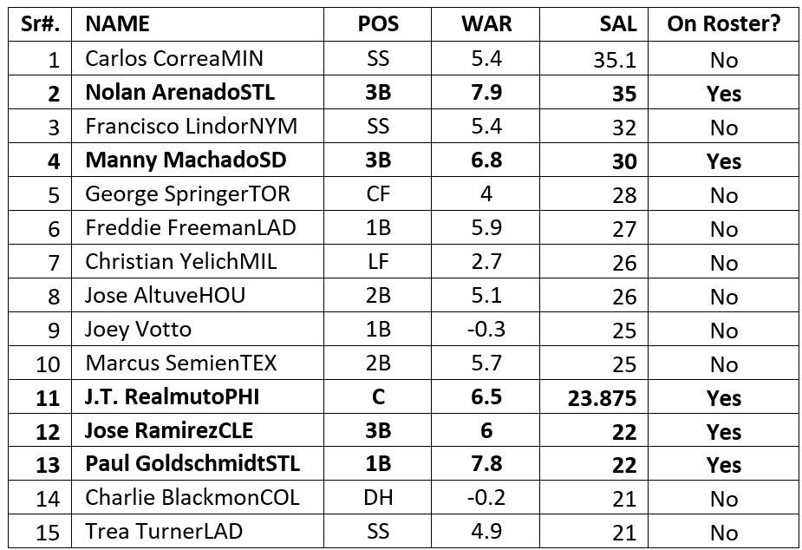
Highest Paid Players
Notes:
We sorted the dataset is descending order by salary. We found that, out of the fifteen highest paid players, there were five on our team (marked in bold characters). We also observed that players with higher salaries didn’t necessarily have higher WAR scores.

Slide 11
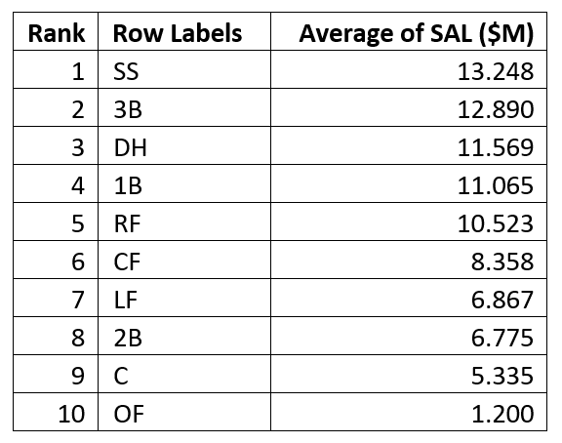
Ranks Of Positions By Average Salary
(1= highest, 10= lowest)
Notes:
We used a pivot table to calculate average salary for each position. Then we sorted the results in descending order to rank the positions from highest to lowest. We found that SS (shortstop) was the position with the highest average salary.

Slide 12
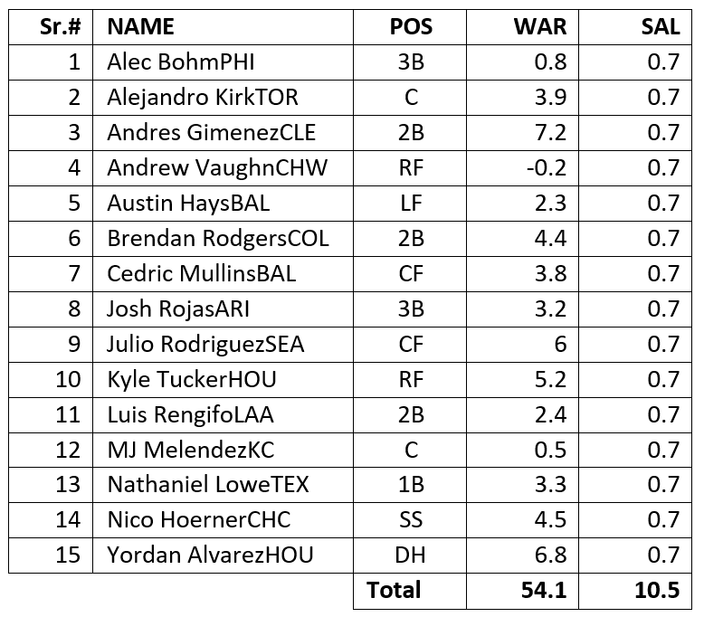
The Minimum Salary Team
Notes:
We ran solver with the objective of minimizing total salary. We found that the minimum total salary possible for a team is $10.5M. Such a team has a low WAR score of 54.1

Slide 13
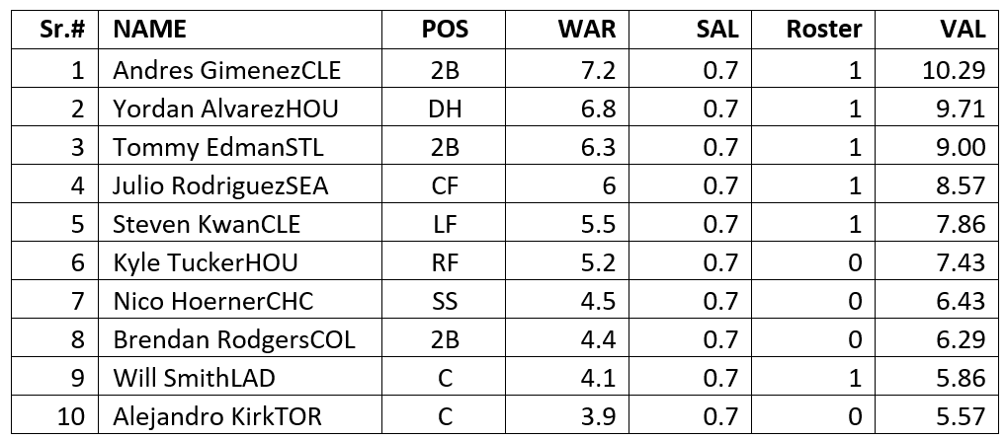
Relative Player Value - The ‘VAL’ Variable
Notes:
To come up with a measure of relative value for each player, we used Billy Beane’s strategy. We came up with the VAL variable, which compares the value a player brings to the team (WAR) to what the player costs the team (SAL). So, this variable identifies players that bring most value to team for the price the team pays for them. The table shows the top 10 most valuable players in the dataset, out of which 6 are on our team.

Slide 14
Thank You!
Notes:
Add potential questions classmates and professor might ask

